Slide 1

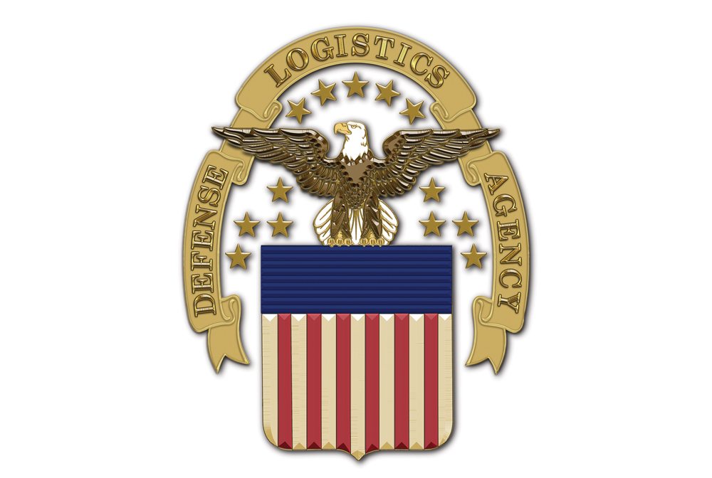






Tolerating Compound Threats in Critical Infrastructure Control Systems
Sahiti Bommareddy‡, Maher Khan†, Huzaifah Nadeem†, Benjamin Gilby†, Imes Chiu§, John W. van de Lindt¶, Omar Nofal∥, Mathaios Panteli††, Linton Wells II‡‡, Yair Amir‡, Amy Babay†
†University of Pittsburgh, ‡Johns Hopkins University, §Defense Logistics Agency, ¶Colorado State University, ∥Florida International University, ††University of Cyprus, ‡‡George Mason University
Notes:
Hello. My name is <name> and I will be presenting our work on <title>. I’m from the university of Pittsburgh but this was an interdisciplinary collaboration with computer scientists, civil engineers, and electrical engineers from these universities and the Defense Logistics Agency

Slide 2
What does ‘Compound Threat’ refer to?
Cyberattack in the aftermath of a natural hazard.
Prior work has covered:
Crash Faults
Byzantine Failures
Not both together

Slide 3
An emerging trend of such sophisticated attacks
During the 2021 Multi-State Information Sharing and Analysis Center annual exercises, 10 scenarios involved planning for the dual impact of a cyberattack and a natural disaster [JB21]
[JB21] “Natural disasters can set the stage for cyberattacks,” https://www.securityinfowatch.com/cybersecurity/news/21244746/natural-disasters-can-set-the-stage-for- cyberattacks, November 2021, retrieved August 16, 2024.
Notes:
Government interest

Slide 4
An emerging trend of such sophisticated attacks
After Hurricane Harvey in 2017, the U.S. Army Cyber Institute conducted a three-day drill simulating a cyberattack during a hurricane [JB21]
[JB21] “Natural disasters can set the stage for cyberattacks,” https://www.securityinfowatch.com/cybersecurity/news/21244746/natural-disasters-can-set-the-stage- for- cyberattacks, November 2021, retrieved August 16, 2024.
Notes:
Government interest

Slide 5
An emerging trend of such sophisticated attacks
Cyberattacks on hospitals are also growing, including attacks during the COVID-19 pandemic [Ghayoomi+21] [SW21]
[Ghayoomi+21] H. Ghayoomi, K. Laskey, E. Miller-Hooks, C. Hooks, and M. Tariverdi, “Assessing resilience of hospitals to cyberattack,” DIGITAL HEALTH, vol. 7, 2021. [Online]. Available: https://doi.org/10.1177/20552076211059366
[SW21] “The growing threat of ransomware attacks on hospitals,” https://www.aamc.org/news-insights/growing-threat-ransomware-attacks-hospitals, July 2021, retrieved August 16, 2024.
Notes:
Government interest

Slide 6
Motivation
Natural hazards are a problem
Existing works only tackle cyberattacks, and not compound threats
Power grids are extremely important for other critical infrastructure systems
An emerging trend of sophisticated cyberattacks on damaged infrastructure
Notes:
On existing works: as we’ll see compound threats presents more challenges than just plain cyberattacks and just natural hazards (just crashes).

Slide 7
Goal
Analyze system design implications of compound threats for power grid SCADA systems

Slide 8
Outcome
Our work shows that compound threats remain a challenging problem with no complete solution
BUT
Explicitly considering natural hazards in system design can improve resilience (next few slides)
Reconfiguration can help (will get to this later)

Slide 9
Contributions
Compound threat model
Compound-Threat Analyzer
Case studies for sites in Hawaii and Florida
No existing SCADA architectures (including state of the art architectures) adequately addresses the compound threat problem (next)
Reconfiguration can help (will get to this later)
Reconfiguration capability in Spire [Babay+18]
[Babay+18] A. Babay, T. Tantillo, T. Aron, M. Platania, and Y. Amir, “Network-attack-resilient intrusion-tolerant SCADA for the power grid,” in
IEEE/IFIP International Conference on Dependable Systems and Networks (DSN), June 2018, pp. 255–266.
Notes:
4. == Our work shows that compound threats remain a challenging problem with no complete solution

Slide 10
System and Threat Model

Slide 11
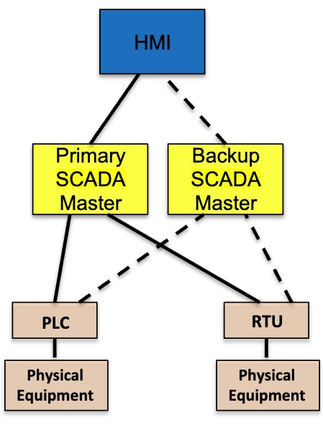
Supervisory Control and Data Acquisition (SCADA)
SCADA systems provide power grids with monitoring and control capabilities
Components:
Human Machine Interface (HMI)
SCADA Master (SM)
Programmable Logic Controllers (PLCs) and Remote Terminal Units (RTUs)
Conventional SCADA system architecture
(reproduced from [Babay+19])
[Babay+19] A. Babay, J. Schultz, T. Tantillo, S. Beckley, E. Jordan, K. Ruddell, K. Jordan, and Y. Amir, “Deploying intrusion-tolerant SCADA for the
power grid,” in 49th Annual IEEE/IFIP International Conference on Dependable Systems and Networks (DSN), Portland, Oregon, June 2019

Slide 12
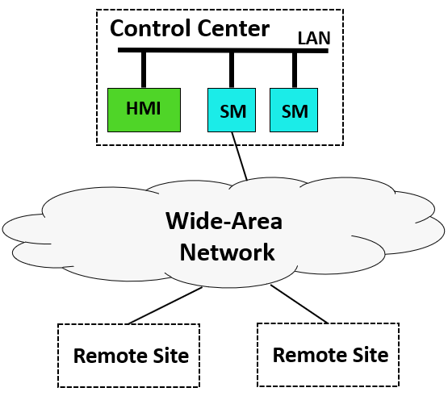

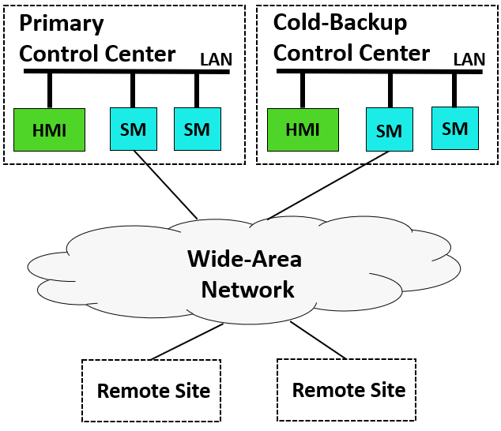




SCADA Architectures
Current Industry-Standard SCADA Architectures [Babay+18]
Configuration “2”
Configuration “2-2”
[Babay+18] A. Babay, T. Tantillo, T. Aron, M. Platania, and Y. Amir, “Network-attack-resilient intrusion-tolerant SCADA for the power grid,” in
IEEE/IFIP International Conference on Dependable Systems and Networks (DSN), June 2018, pp. 255–266.
Notes:
This is Fig 1 (a) = left and (b) = right in the paper.
Left can tolerate one SM CRASH only. Right can tolerate one SM crash AND primary site unavailability (with manual intervention – delay in the order of minutes)
These are NOT Intrusion tolerant and NEITHER Network attack resilient

Slide 13
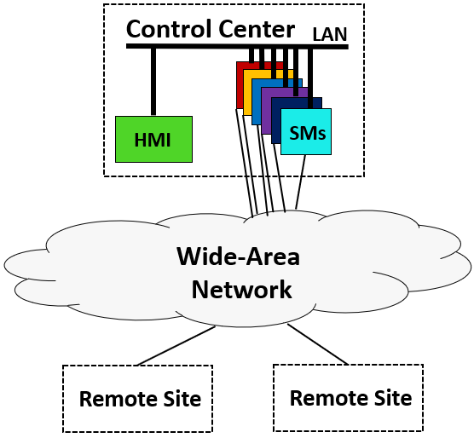
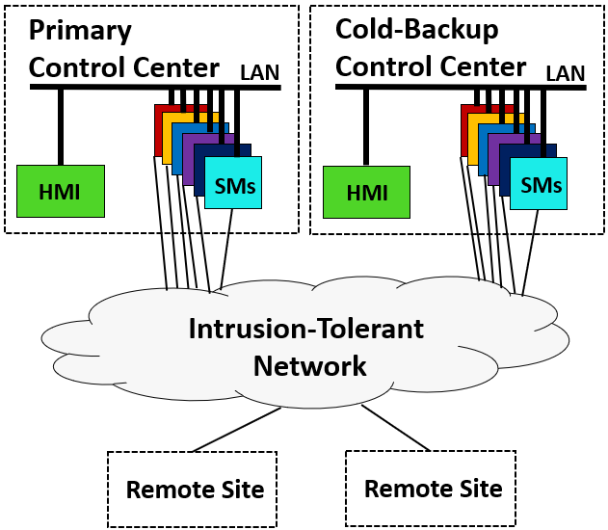

SCADA Architectures
Intrusion Tolerant Architectures [Babay+18]
Byzantine fault tolerant replication
Configuration “6”
Configuration “6-6”
[Babay+18] A. Babay, T. Tantillo, T. Aron, M. Platania, and Y. Amir, “Network-attack-resilient intrusion-tolerant SCADA for the power grid,” in
IEEE/IFIP International Conference on Dependable Systems and Networks (DSN), June 2018, pp. 255–266.
Notes:
This is Fig 3 (a) = left and (b) = right in the paper.

Slide 14
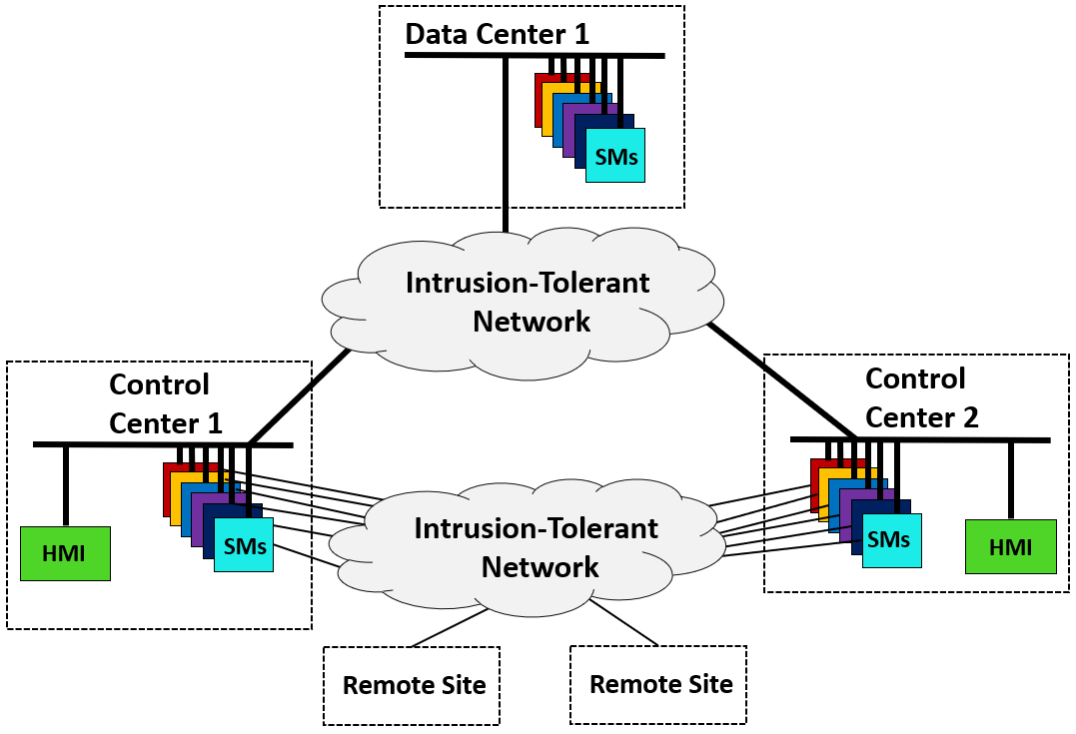



SCADA Architectures
Network-Attack-Resilient Intrusion-Tolerant Architecture [Babay+18]
Configuration “6+6+6”
[Babay+18] A. Babay, T. Tantillo, T. Aron, M. Platania, and Y. Amir, “Network-attack-resilient intrusion-tolerant SCADA for the power grid,” in
IEEE/IFIP International Conference on Dependable Systems and Networks (DSN), June 2018, pp. 255–266.
Notes:
MENTION DATA CENTER
This is Fig 4 (a) = left and (b) = right in the paper.
Simultaneous one intrusion + one site isolation

Slide 15
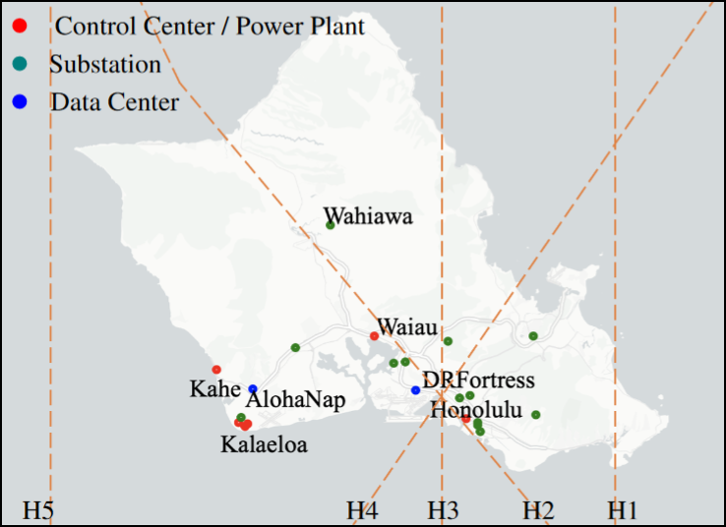
Sites and Configurations
Hawaii
Honolulu + Waiau + DRFortress
Honolulu: already used
Waiau: central location + good connectivity
+ under consideration in future
DRFortress: commercial data center
Hurricanes: 5 hurricanes simulated
Hurricane paths used by emergency planners
Hurricane realizations using a wave-surge model based on ADvanced CIRCulation model [LWS92]
[LWS92] R. A. Luettich, J. J. Westerink, and N. W. Scheffner, “ADCIRC: an advanced three-dimensional circulation model for shelves, coasts, and
estuaries. report 1, theory and methodology of ADCIRC-2DD1 and ADCIRC-3DL,” Dredging Research Program, U.S. Army Engineers
Waterways Experiment Station, Vicksburg, MS, Tech. Rep. DRP-92-6, 1992.
Notes:
around 10 min ok until here
This is Fig 5 in the paper.

Slide 16
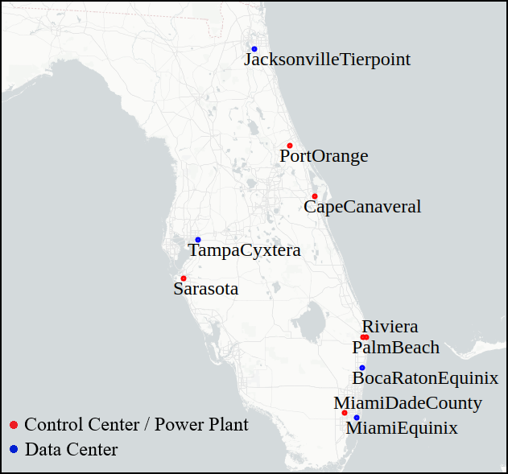
Sites and Configurations
Florida
Palm Beach + Port Orange + Jacksonville Tierpoint
Palm Beach: currently used & invested in
Port Orange: currently used as backup (public info.)
Jacksonville Tierpoint: commercial data center
Hurricanes: No hurricane paths but a worst-case scenario
not feasible to simulate hurricane impacts at the scale of the whole site
100-year flood hazard intensity for each site
Basically, the level of flooding that has a 1% chance of being reached or exceeded each year
Based on NOAA’s and FEMA’s models
Notes:
This is Fig 6.
Reason for HI FL difference: Detailed flooding data not available for FL (due to large size of the state)
NOAA = National Oceanic and Atmospheric Administration
FEMA = Federal Emergency Management Agency

Slide 17
System operational states outcomes
Colored states from Spire [Babay+18]
Green: all good
Red: system not operational but safe
Orange: non-operational until back up restored
Gray: compromise
[Babay+18] A. Babay, T. Tantillo, T. Aron, M. Platania, and Y. Amir, “Network-attack-resilient intrusion-tolerant SCADA for the power grid,” in
IEEE/IFIP International Conference on Dependable Systems and Networks (DSN), June 2018, pp. 255–266.
Notes:
Explain what safe means

Slide 18
Threat Scenarios & Attack Models
Threat scenarios:
Natural Hazard
Natural Hazard + Server intrusion
Natural Hazard + Site isolation (e.g. by DDOS)
Natural Hazard + Server intrusion + Site isolation
Attack Models
Worst case
Deterministic
gray > red > orange > green
Uniformly Random

Slide 19
Results
Notes:
15 min mark

Slide 20
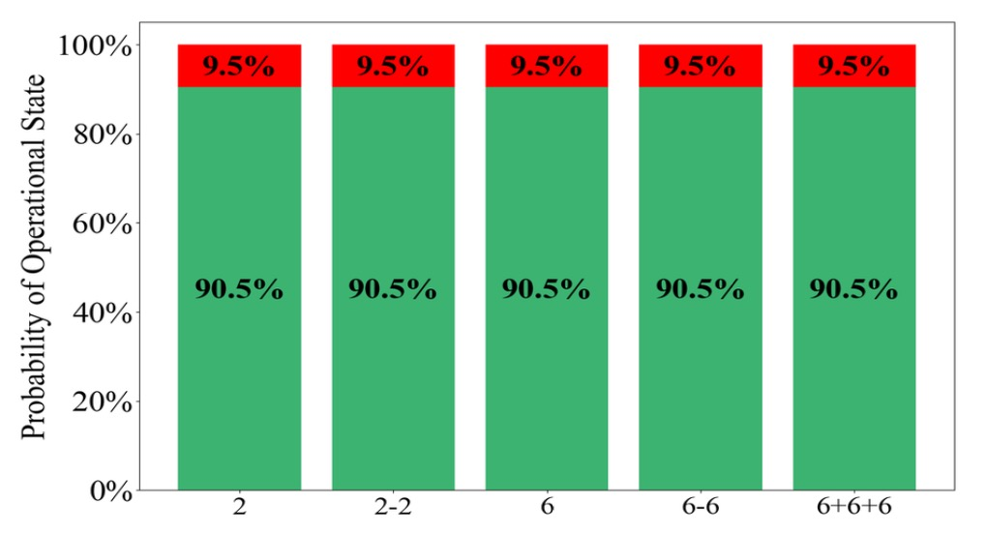
Worst-case (Hawaii)
Hurricane only (No Cyberattack)
Control Center 1 (CC1): Honolulu
Control Center 2 (CC2): Waiau
Data Center (DC) : DRFortress
DC alone cannot keep the system running
CC1 and CC2 go down together in 9.5% of the instances. DC remains safe
CC1, CC2, and the DC survive the hurricane

Slide 21
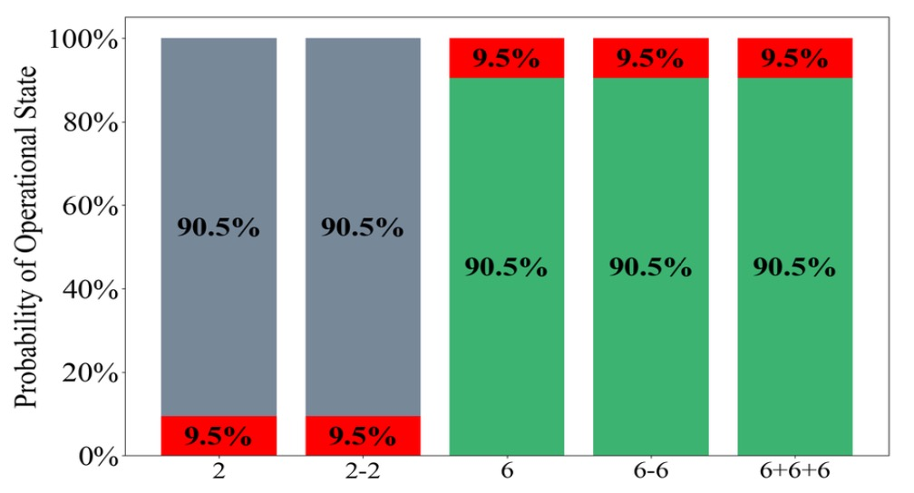
Worst-case (Hawaii)
Control Center 1 (CC1): Honolulu
Control Center 2 (CC2): Waiau
Data Center (DC) : DRFortress
Hurricane + Server Intrusion
When CC1 survives the hurricane, the intrusion takes us to the compromised state (gray)
The intrusion is not a problem the intrusion tolerant architectures
(otherwise, same as previous slide)
The hurricane takes the CCs down before the attacker gets a chance to attack
Notes:
only need to explain red for 2 and 2-2 (other ones repeat prev slide)

Slide 22
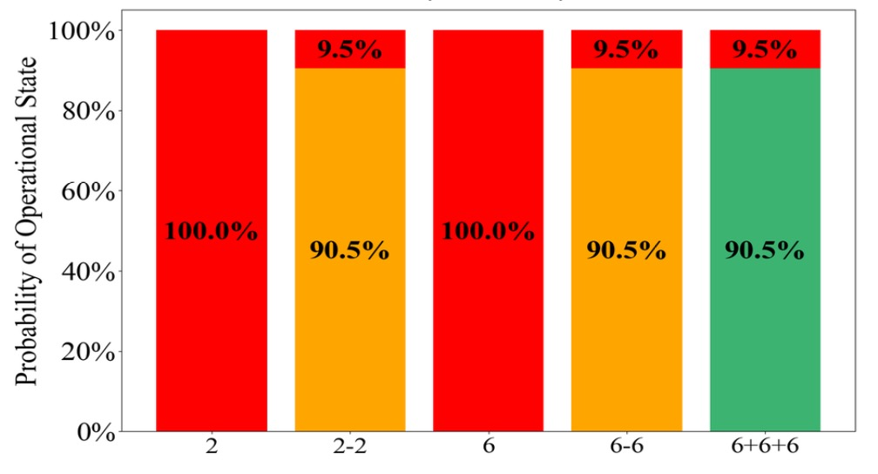
Worst-case (Hawaii)
Control Center 1 (CC1): Honolulu
Control Center 2 (CC2): Waiau
Data Center (DC) : DRFortress
Hurricane + Site Isolation
When all of our sites are down (due to either the hurricane ( in 2-2, and 6-6) and both the hurricane + the attack (6+6+6)
This architecture can tolerate 1 Site Isolation (CC1 and CC2 survive the hurricane in 90.5% of instances).
Where we have two sites, when they survive the hurricane (90.5% of the instances), because of the site isolation, we need to manually move to the back up (delay)
There is only one site (CC1). So even when it survives the hurricane, site isolation takes us to the red state (not operational but safe)
Notes:
previewing what to expect with random is probably too much to explain here

Slide 23
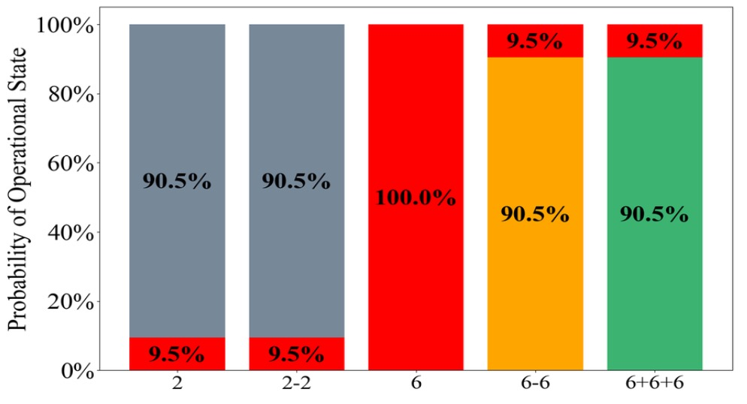
Worst-case (Hawaii)
Control Center 1 (CC1): Honolulu
Control Center 2 (CC2): Waiau
Data Center (DC) : DRFortress
Hurricane + Server Intrusion + Site Isolation
The two non intrusion-tolerant architectures are in the compromised state when the CCs survive the hurricane.
When the CCs do not survive the hurricane, we get the non-operational state since the attacker have nothing to attack. Reminder: for Hawaii, both CCs go down together.
Same as before.
(These are intrusion tolerant configurations)

Slide 24
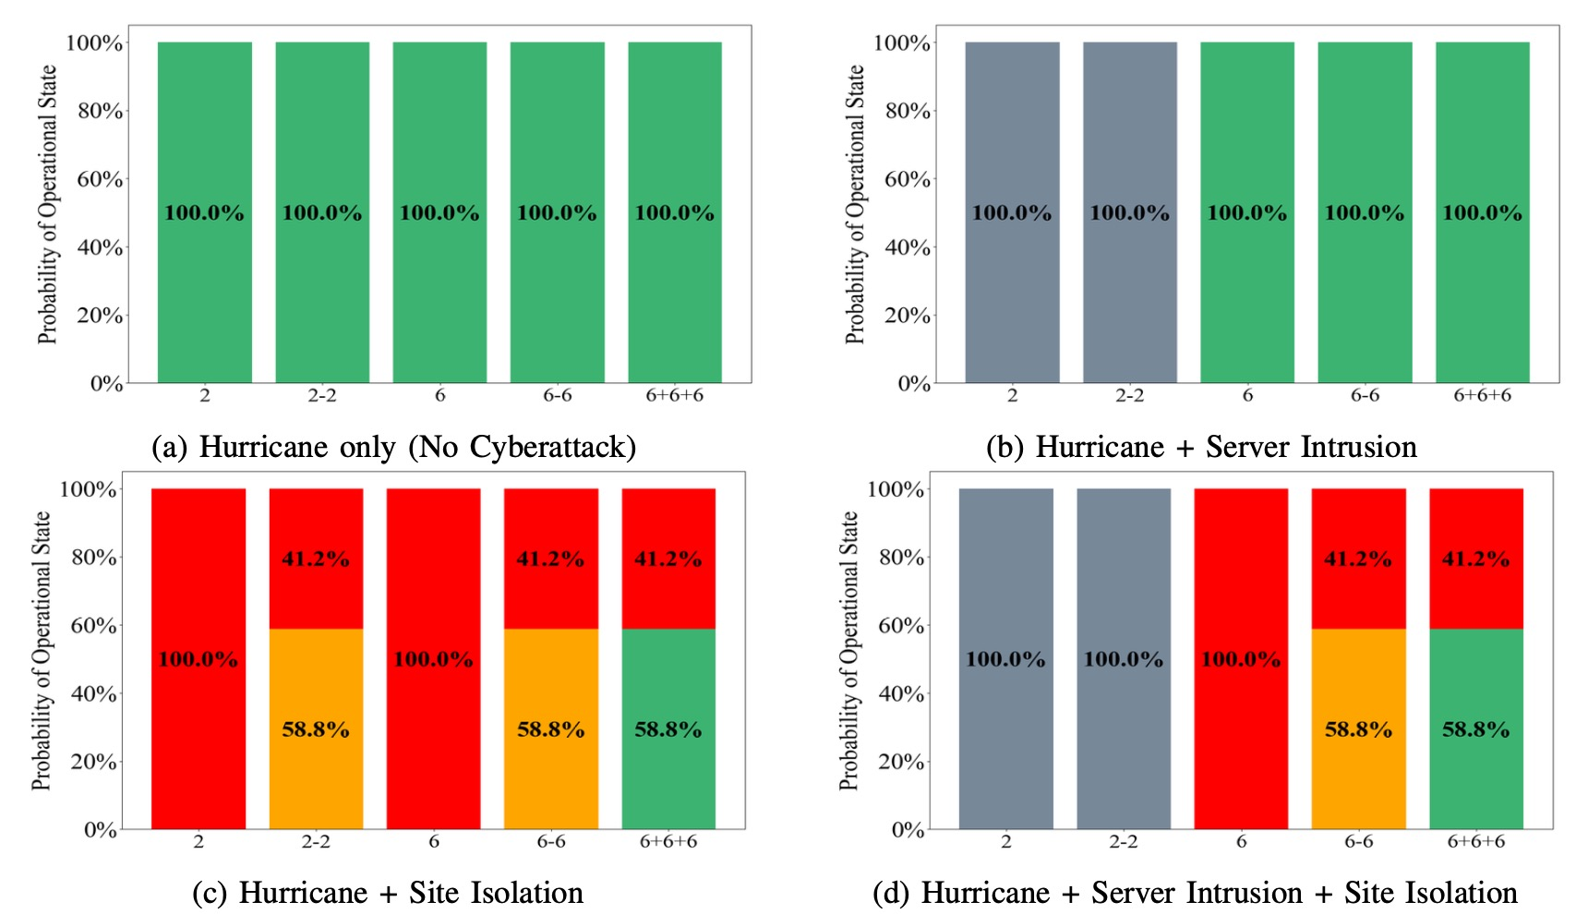
Worst-case (Florida)
Control Center 1 (CC1): Palm Beach
Control Center 2 (CC2): Port Orange
Data Center (DC) : Jacksonville Tierpoint
100% ‘all good’ (green) state even with the hurricane?
FPL invested in a Category-5-hurricane-resilient control center at Palm Beach. So, the investment pays off!
We still have cyberattacks (intrusions) to worry about in these two configurations
We are good here because of the hurricane-resistant CC1 and the intrusion tolerant configurations
Notes:
FPL = Florida Power & Light

Slide 25
Worst-case (Florida)
Control Center 1 (CC1): Palm Beach
Control Center 2 (CC2): Port Orange
Data Center (DC) : Jacksonville Tierpoint
Even though CC1 survives the hurricane, the attacker isolates it. We can move to the back up in 2-2 and 6-6 (with delay) IF it survived the hurricane (58.5%).
These are intrusion tolerant. Other than that, same logic follows as in just Hurricane + Site Isolation scenario.
Unlike Hawaii, we do not get any red state for these. Since CC1 (Palm Beach) always survives the hurricane, the intrusion will get us.
6+6+6 can still function when CC2 survives the hurricane (and CC1 is isolated).
Notes:
FPL = Florida Power & Light

Slide 26
Takeaways from Worst-case results
Only configuration “6+6+6” is able to tolerate both server intrusion and site isolation attacks: it maintains a green operational state as long as the control centers survive the hurricane
Hurricane-resilient sites (such as Palm Beach) can help with the hurricane
But, this is not enough to withstand compound threats involving site isolation attacks

Slide 27
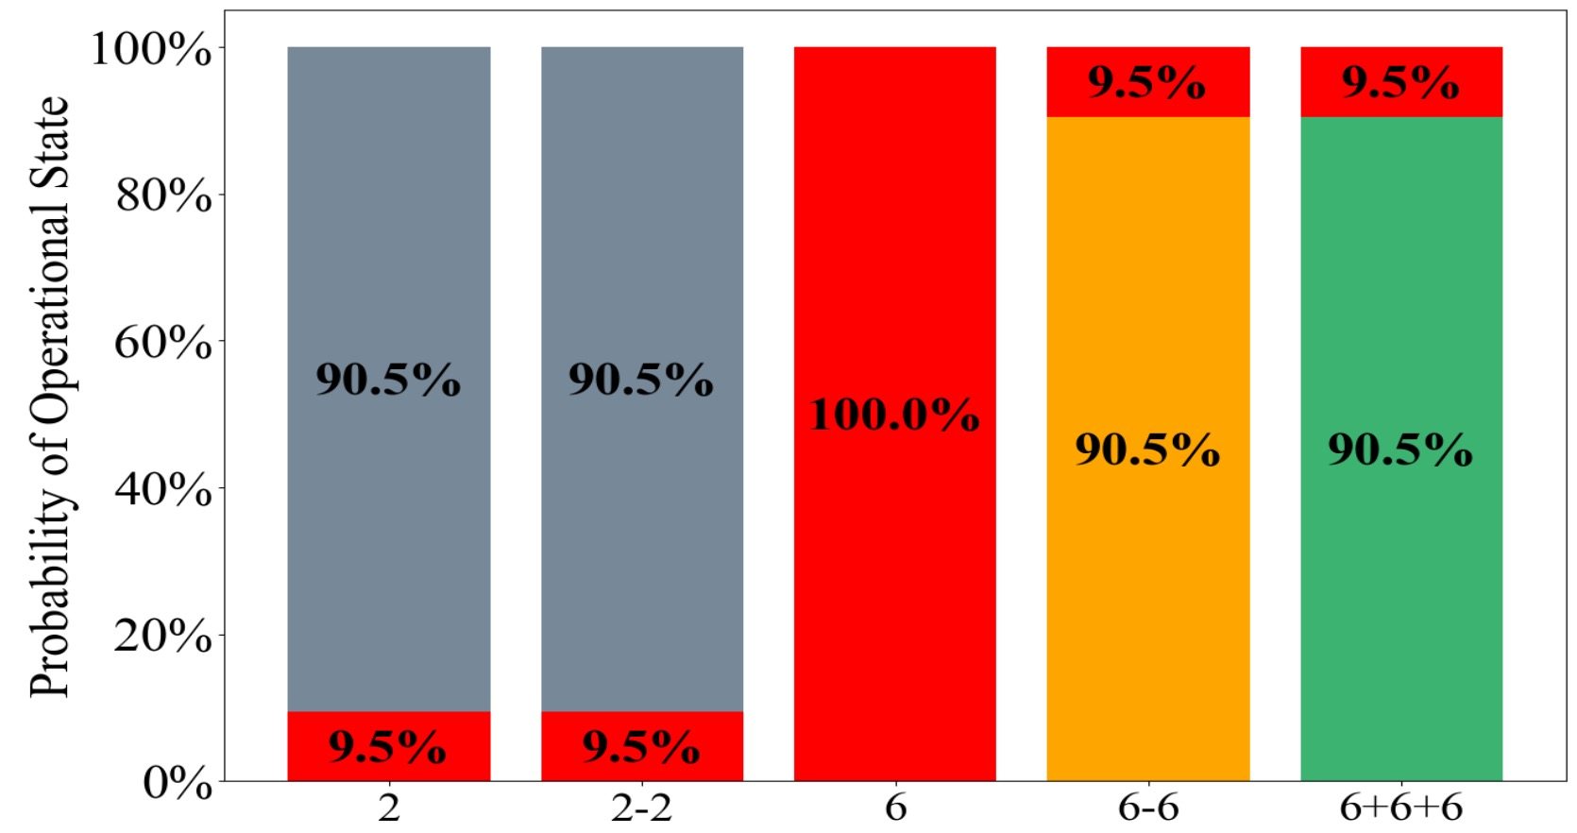
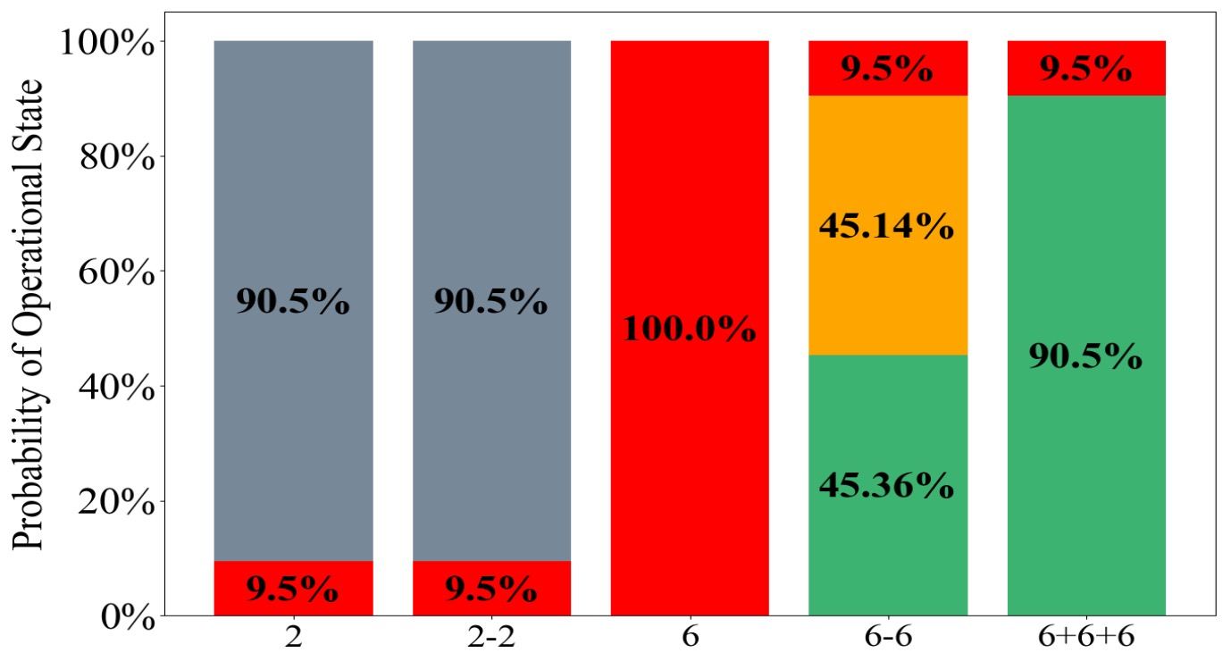
Random (Hawaii)
In the random model, the attacker can target the back up CC. We are still in the green state in that situation.
Hurricane + Server Intrusion + Site Isolation
Worst-Case Attack Model
(for comparison)
Uniformly Random Attack Model
Notes:
For HI: with WC, 6-6 was 90.5% orange. Now that orange is divided into orange and green. Rest all same
Conclusion: random provides a diff view. Essentially a range WC-Random. Single sites not good at all. Diffs in two sited. Three sited not much diff.

Slide 28
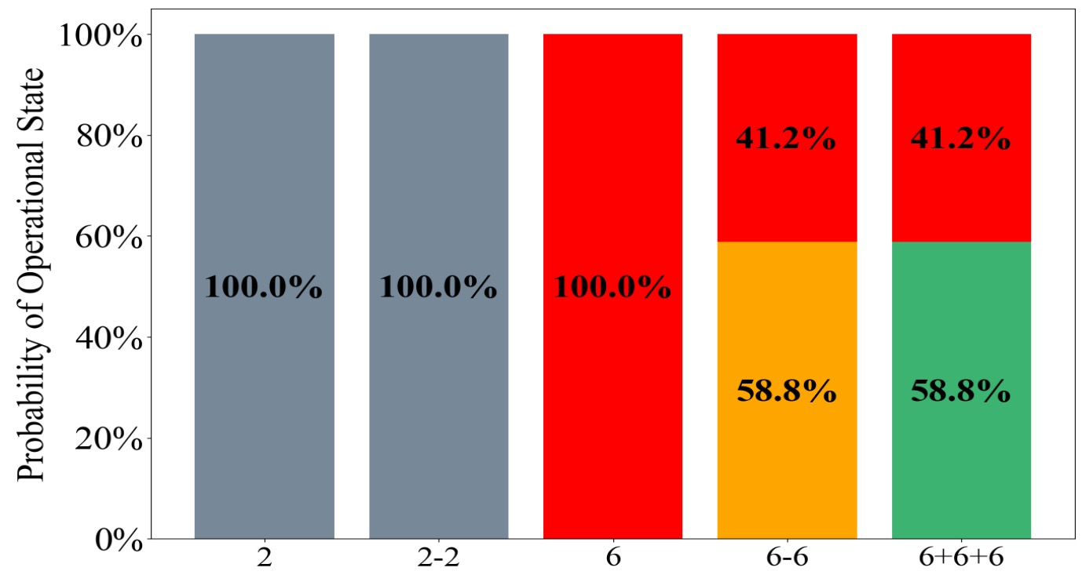
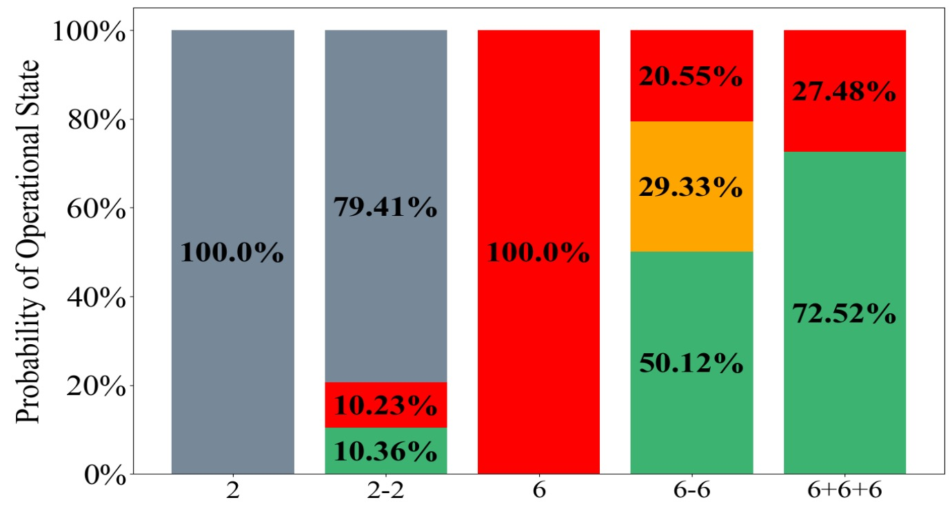
Random (Florida)
In worst-case, the attacker always attacked the primary CC.
In random, it can be either one.
Hurricane + Server Intrusion + Site Isolation
Worst-Case Attack Model
(for comparison)
Uniformly Random Attack Model
Notes:
For FL: with WC, in 2-2 red and green. In 6-6 diff percentages and 3 colors now (in WC it was red + orange). 6+6+6 diff percentages same colors

Slide 29
Random (Florida)
Similar to Hawaii, the attacker can attack the back up.
But, the percentage of red is different?
Hurricane + Server Intrusion + Site Isolation
Worst-Case Attack Model
(for comparison)
Uniformly Random Attack Model
Notes:
For FL: with WC, in 2-2 red and green. In 6-6 diff percentages and 3 colors now (in WC it was red + orange). 6+6+6 diff percentages same colors

Slide 30
Random (Florida)
The values are different. In Hawaii, the two CCs went down together. In Florida, that is not always the case.
Hurricane + Server Intrusion + Site Isolation
Worst-Case Attack Model
(for comparison)
Uniformly Random Attack Model
Notes:
For FL: with WC, in 2-2 red and green. In 6-6 diff percentages and 3 colors now (in WC it was red + orange). 6+6+6 diff percentages same colors

Slide 31
Random (Florida)
For “6+6+6”, when Port Orange (CC2) is flooded, the attacker can isolate
either Palm Beach or the data center at Jacksonville
We get worse results (with regards to the red state) for 6+6+6 as compared to 6-6?
Hurricane + Server Intrusion + Site Isolation
Worst-Case Attack Model
(for comparison)
Uniformly Random Attack Model
Notes:
For FL: with WC, in 2-2 red and green. In 6-6 diff percentages and 3 colors now (in WC it was red + orange). 6+6+6 diff percentages same colors

Slide 32
Takeaways from Random results
An important drawback of the generally more resilient configuration “6+6+6”:
It can become non-operational even when one control center remains fully correct and available
Random attack model results show that the inability of existing architectures to withstand compound threats is not an artifact of the strong worst-case selection model
Even under this weaker model, no architecture achieves a fully available (green) operational profile

Slide 33
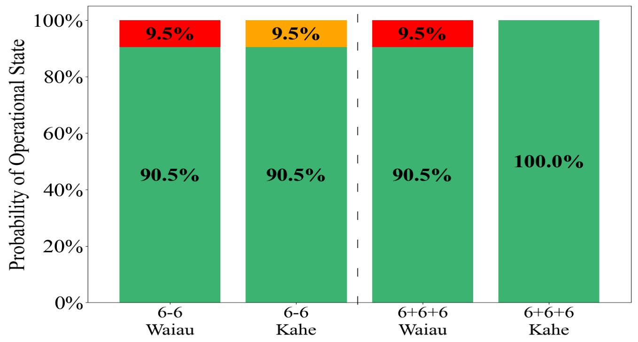
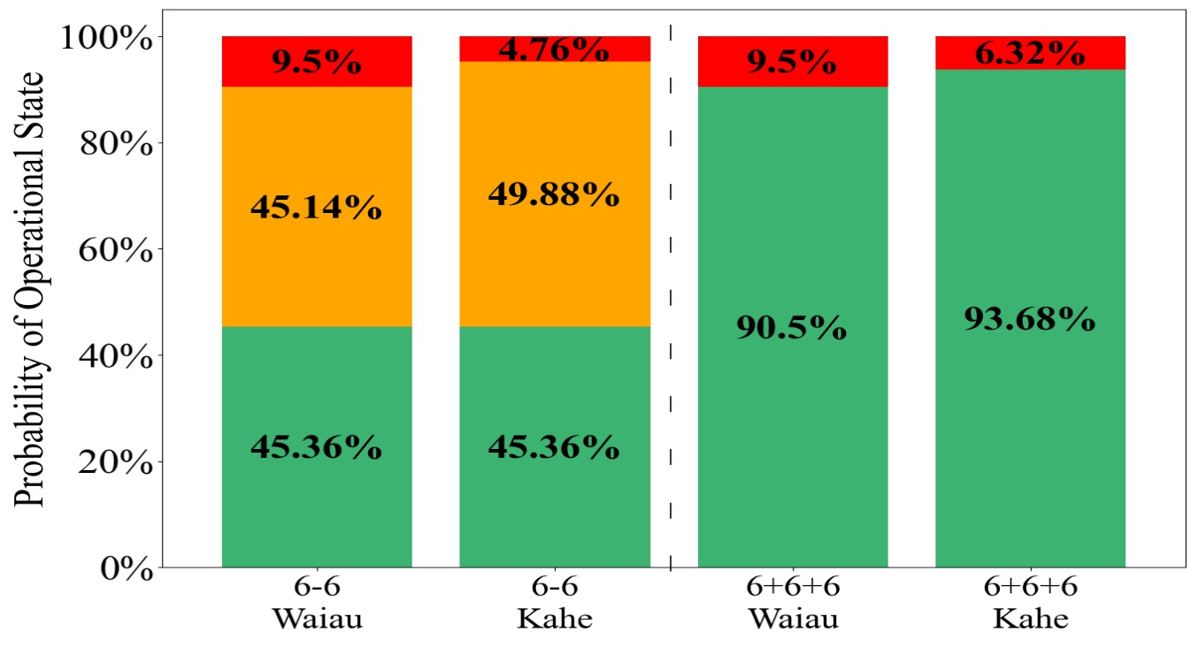
Alternative Sites
Control Center 1 (CC1): Honolulu
Control Center 2 (CC2): Waiau / Kahe
Data Center (DC) : DRFortress
Honolulu and Waiau always went down together.
But Honolulu and Kahe never go down at the same time
With Kahe as our CC2, when Honolulu goes down, Kahe and DRFortress can keep the system fully available
If the attacker can isolate any site, we are better with the choice of Kahe, but still not completely resilient
Worst-Case
(Hurricane + Server Intrusion)
Uniformly Random
(Hurricane + Site Isolation)
Notes:
Currently, Waiau is planned as a backup because it is a location with strong network connectivity and resources. But due to geographical profile, it may not be the best choice
“slightly confusing to compare different threat models; make this clear in explanation”

Slide 34
Takeaways from Alt. Sites results
It is possible to improve resilience by explicitly considering the natural hazard in designing the system
However, even when natural hazard impacts are used to guide the control center selection, there is still no architecture that completely withstands the full compound threat model

Slide 35
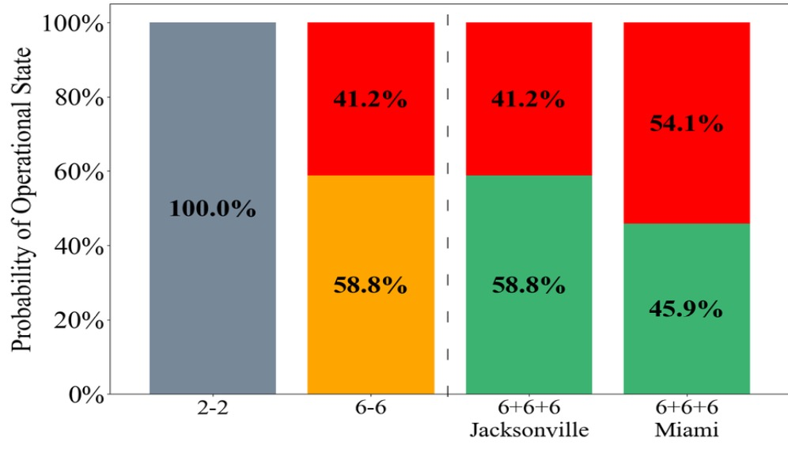
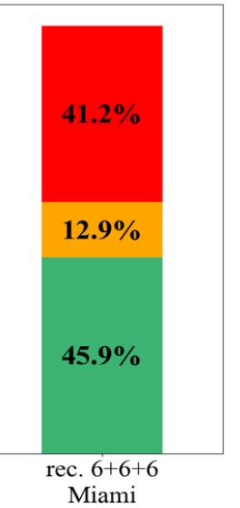
Reconfiguration
However, when we have one of the CCs available, we can reconfigure to a “6” configuration
We chose Jacksonville for our DC, but Miami was an equally good choice (from a geographical perspective)
Normally 6+6+6 is better than 6-6
An example for Florida:
But when one of the CCs and DC become unavailable, we get worse results.
And get strictly better results than 6-6
Worst-Case Analysis:
Server Intrusion + Site Isolation
Notes:
Miami was equally as good as Jacksonville from a geographical perspective so we picked Jack.. But we could have gone for miami too

Slide 36
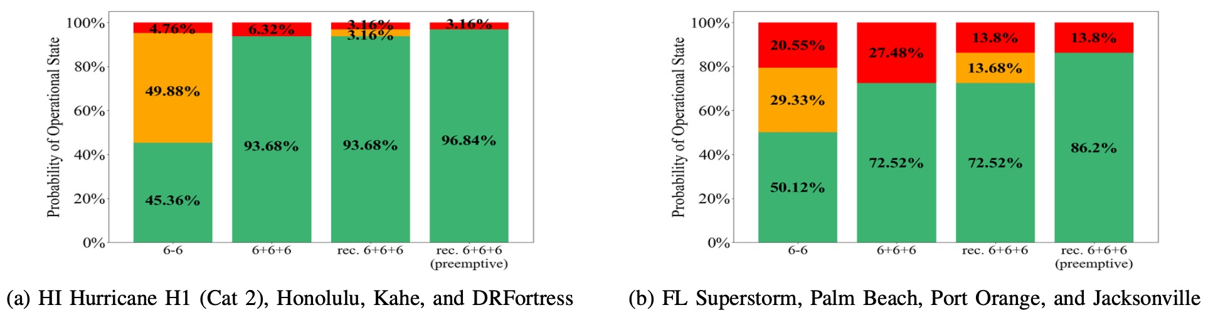
Reconfiguration
It is also possible to reconfigure
preemptively to exclude the data center in situations where it makes us more vulnerable e.g. when the DC is already unavailable, or when a CC is flooded or isolated.
With Random Model
Server Intrusion + Site Isolation
Notes:
Further new: preemptive

Slide 37
Takeaways from Reconfig. results
Reconfiguration can help us resume operation in some situations
If there is time to reconfigure the system after losing one site but before losing the other, then preemptive reconfiguration avoids the temporary interruption (orange state), converting it to green.
Thus, with the addition of reconfiguration, “6+6+6” becomes strictly better than “6-6”.

Slide 38
Conclusion
Our work shows that compound threats remain a challenging problem with no complete solution
BUT
Explicitly considering natural hazards in system design can improve resilience
e.g. for Hawaii, Kahe is a better choice over Waiau
Reconfiguration can help
e.g. with the addition of reconfiguration, “6+6+6” becomes strictly better than “6-6”

Slide 39


Questions? h.nadeem@pitt.edu
Compound-Threat Analyzer can be found at:
https://github.com/spire-resilient-systems/compound_threat_analyzer

Slide 40
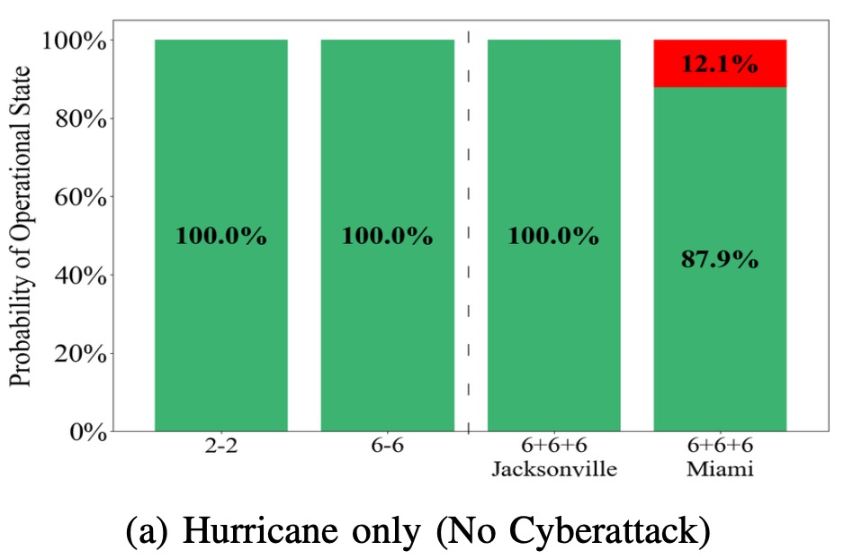
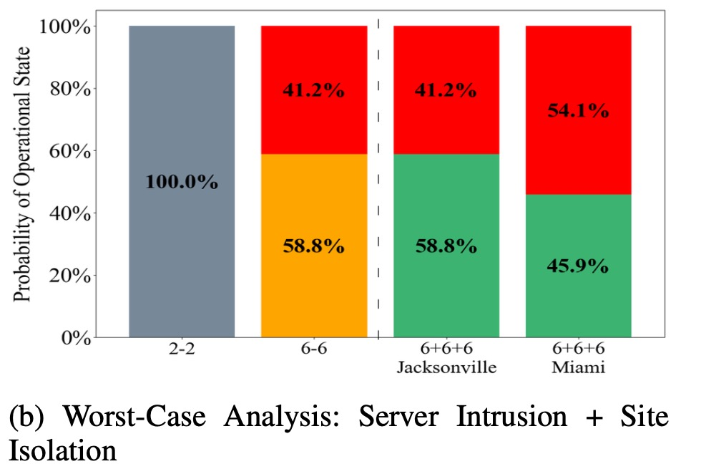
Alternative Sites
Data Center for Florida:
Notes:
Alt sites for CC2

Slide 41
Out-of-Band vs. In-band reconfiguration
Why manual OOB reconfiguration?
Attackers may try to exploit use the automatic reconfiguration mechanism e.g. use repeated reconfiguration requests as a DOS attack, or to reconfigure to replicas they control.
For in band, need a quorum of up and correct replicas to reconfigure

Slide 42
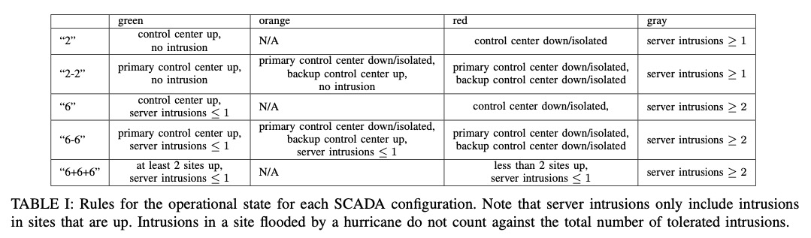

Slide 43
Tolerating Compound Threats in Critical Infrastructure Control Systems
Sahiti Bommareddy‡, Maher Khan†, Huzaifah Nadeem†, Benjamin Gilby†, Imes Chiu§, John W. van de Lindt¶, Omar Nofal∥, Mathaios Panteli††, Linton Wells II‡‡, Yair Amir‡, Amy Babay†
†University of Pittsburgh, ‡Johns Hopkins University, §Defense Logistics Agency, ¶Colorado State University, ∥Florida International University, ††University of Cyprus, ‡‡George Mason University
Notes:
I’m from the university of Pittsburgh but this was a collaborative work with these universities and the DLA. It was an interdisciplinary collaboration with from computer scientists, civil engineers, electrical engineers .

Slide 44

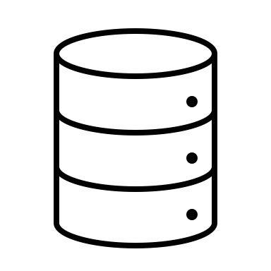


What does ‘Compound Threat’ refer to?
Cyberattack in the aftermath of a natural hazard.
Prior work has covered:
Ex. 1: One site flooded
Ex. 2: One site attacked
Ex. 3: Both
✓
✓
: ✓
: ✓
✓
: ✗

Slide 45
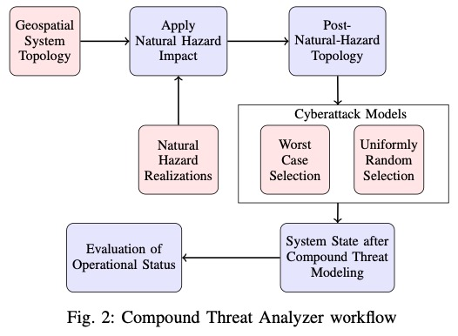
Analysis tool:

